Slide 1
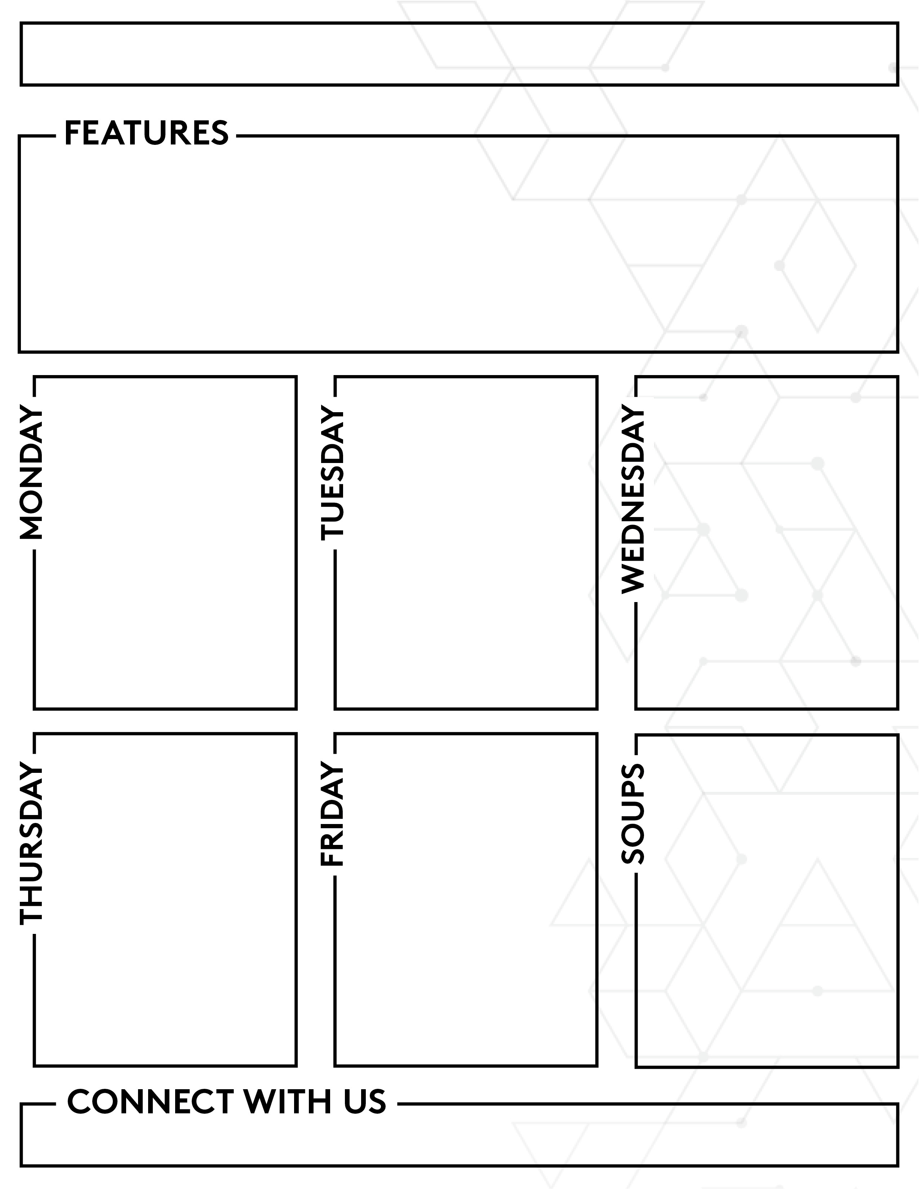













August 24-28 7:30AM-9:30AM, 11:00AM-1:30PM
1300 Café
Menu is subject to change based on staffing and product availability
MONDAY
TUESDAY
WEDNESDAY
THURSDAY
FRIDAY
Hawaiian Fido Not Chi Dog Frank Bahn Mi Mexican Street Corn Dog Tater Tots Blue Cheese Coleslaw
Baked Chicken Wings Korean Style Fried Chicken Wings Celery & Carrot Sticks Jo Jo Potato Wedges Smoked Gouda Mac & Cheese Assorted Sauces & Dips
Check Out our Special Today!!
BBQ Spiced Salmon Maryland Crab Cakes Country Cheese Grits Smashed Red Potatoes Summer Succotash Sweet & Spicy Brussels Corn Relish Lemon Wedges Cocktail & Tartar Sauce Mango Salsa
MONDAY Cheesy Potato
TUESDAY Chicken Chili
WEDNESDAY Beef & Veggie
THURSDAY Pozole Verde
FRIDAY Du Jour
YourInstaEatInfoV1
Chef Inspired
YourInstaEatInfoV2
555.555.5555
www.YourCafeWebsite.com
YourCafeHandle
YourCafeHandle
YourCafeHandle
ClaireEllingson@iammorrison.com
YourCafeHandle
948-204-1662 757-252-1511
AshleighWoodruff@iammorrison.com

Slide 2
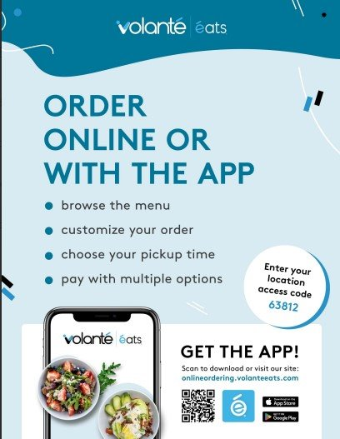
YourInstaEatInfoV1
YourInstaEatInfoV2
555.555.5555
www.YourCafeWebsite.com
YourCafeHandle
YourCafeHandle
YourCafeHandle
YourCafeHandle

